Slide 1
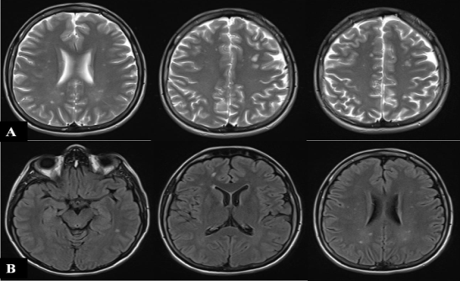
OCCURENCE OF HEADACHES IN CEREBRAL SMALL VESSELS DISEASE (CSVD) – A PILOT STUDY
Marta Jeremić­¹, Aleksandar Stevanović², Nataša Stojanovski³, Marija Petrović⁴, Anja Stefanović⁵, Dušan Radovanović⁴, Jasna Zidverc Trajković¹, Milija Mijajlović¹, Aleksandra M. Pavlović⁶
¹Faculty of Medicine, University of Belgrade, Neurology Clinic, University Clinical Center, Belgrade, Serbia; ²Faculty of Medicine, University of Belgrade, Institute of Social Medicine, Belgrade, Serbia; ³Faculty of Medicine, University of Belgrade, Institute of Human Genetics, Belgrade, Serbia; ⁴Faculty of Medicine, University of Belgrade, Belgrade, Serbia; ⁵Faculty of Phylosophy, Department of Psychology, University of Belgrade, Belgrade, Serbia; ⁶Faculty for Special Education and Rehabilitation, University of Belgrade, Belgrade, Serbia
Background and Aims: Cerebral small vessel disease (CSVD) is caused by atherosclerotic process within the smallest cerebral arteries. Lacunar ischemic infarctions, microhemorrhages and white matter hyperintensities (WMH) are found on CT/MRI. CSVD is the leading cause of vascular dementia and is the fifth most common cause of stroke. Clinically, gait disturbances, vascular parkinsonism, cognitive deficits and depression with slow progression of symptoms characterize the disease. Headaches can also occur. Correlations between migraine, stroke and CSVD were observed but precise pathophysiological mechanisms are lacking. Correlations between migraine and stroke have been identified in some diseases such as Cerebral Autosomal Dominant Arteriopathy with Sub-cortical Infarcts and Leukoencephalopathy (CADASIL) and familiar hemiplegic migraine. Patients suffering from migraine with aura have two times greater risk of stroke than other patients suffering from headaches. Some suggested greater risk of CSVD in patients with headache, especially migraine.
Aim of the study: to investigate frequency and type of headache in cohort of hospitalized patients treated for CSVD.
from medical documentation. All patients had verified CSVD diagnosis based on clinical history, physical examination. MRI and further laboratory testing was conducted to eliminate coagulopathies, neuroinfections as well as lumbar punctions were performed to exclude demyelinating diseases. Headaches were classified according to the international headache classification. Sex, age, presence of headache, type of headache, vascular risk factors and MRI lesions of the brain were used as parameters of interest. Age-Related White Matter Changes (ARWMC) scale was used to asses MRI findings of lacunar infarctions, as well as presence and severity of hyperintensities of white brain matter. Frequency of headache and type of headache as well as the correlation with the MRI changes were assessed.
Discussion: Almost half of our patients with CSVD suffered from some type of headache. Association between headache and lacunar infarctions on MRI showed a strong trend while the existence of WMH was characteristic of patients with CSVD without rather than with headaches. Correlation between stroke, WMH and migraine was well documented. Asymptomatic cerebral ischemia was shown to be more frequent in patients with migraine. Risk of developing WMH or subclinical cerebral infarctions rose with higher frequency of headache. Therapeutic approaches to headache were not assessed, however, medication such as triptans and ergotamine used for treatment of migraine have been associated with higher risk of ischemic cerebrovascular disease and CSVD. Higher ARWMC scores amongst older population and within the male sex can be linked with risk factors such as hypertension, diabetes, smoking, or alcohol consuming. Due to the study nature, no association between time or causation was found. Another limitation was its small sample size. Further investigations on a larger sample with a control group are needed.
Figure 1 Distribution of the types of headache
Results: 47.8% patients were male; mean age was 62±11 years. 6.,6% patients were <65 years. 44% patients had some type of headache of which 37.2% had tension headache whilst 23.5% had migraine and the same number had medication overuse headache. On MRI, lacunar ischemia and WMH was found in 86.1% and 46.1% of patients, respectively. Mean ARWMC score was 9.6. Patients >65 years had more hyperintensities of the white matter (p<0.0001) and higher ARWMC scores (p=0.004). Males had more hyperintensities of white brain matter then females (p=0.013). Hypertension was associated with higher ARWMC scores (p = 0.018). Lacunes detected on MRI were more frequently detected in patients with any type of headache compared to no headache but at the level of statistical trend (p = 0.072). Association of WMH on MRI and headache also approached significance (p=0,065).
Figure 2 Typical MRI findings
A. FLAIR in woman, 48 years, smoker,
had migraine without aura for many years.
B. T2w in male, 43 years, hypertension and
smoker, hypertensive headache.
ITEM | N pts (value)
Lacunar infarctions, N(%) | 99 (86,.)
WMH, N(%) | 53 (46.1)
ARWMC score, x ± SD (median) | 9.6 ± 5.7 (8.5)
Conclusions: Our study showed that headache is associated with specific neuroradiological characteristics in patients with sporadic CSVD. It was possible to differentiate subpopulations with CSVD with specific mechanisms of arterial damage, having a different course of the disease and hence requesting a different treatment strategy.
Methods: 115 patients hospitalized due to CSVD in the Clinic of neurology, Clinical center of Belgrade, Serbia were recruited in the pilot study during the period from 01.01.2015 until 31.12.2017. Data was obtained retrospectively
Table 1 .Severity of lesions on MRI

